Slide 1



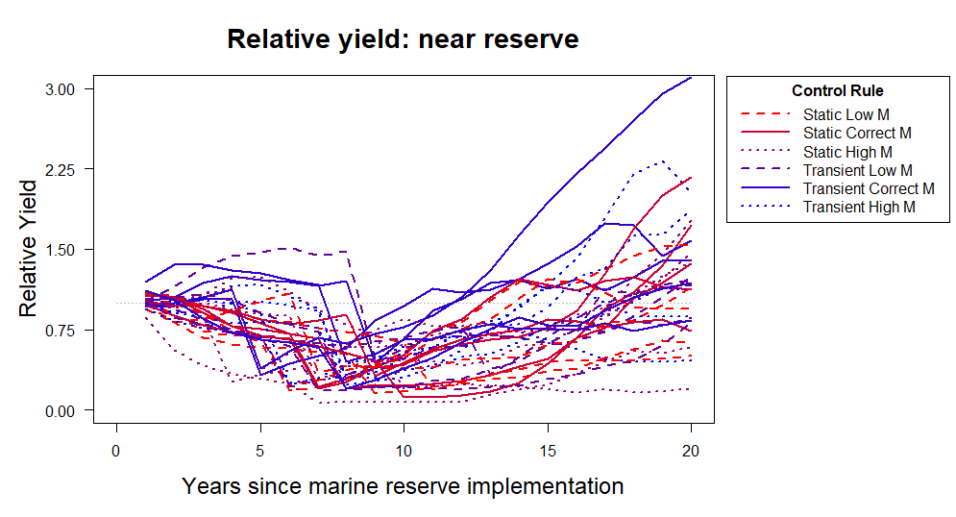
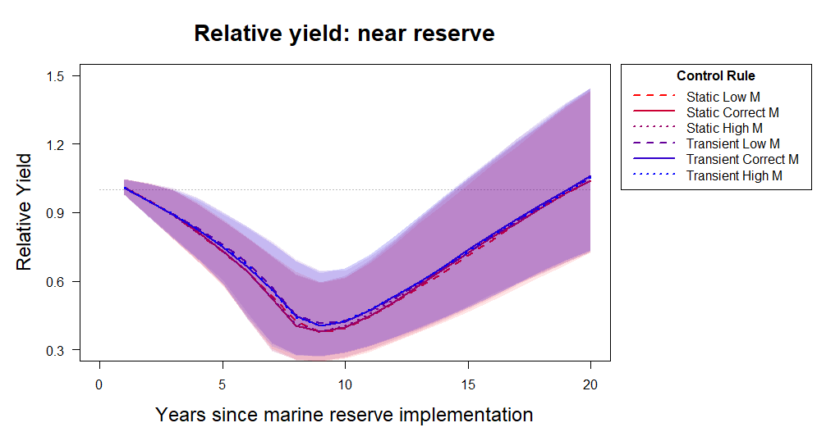
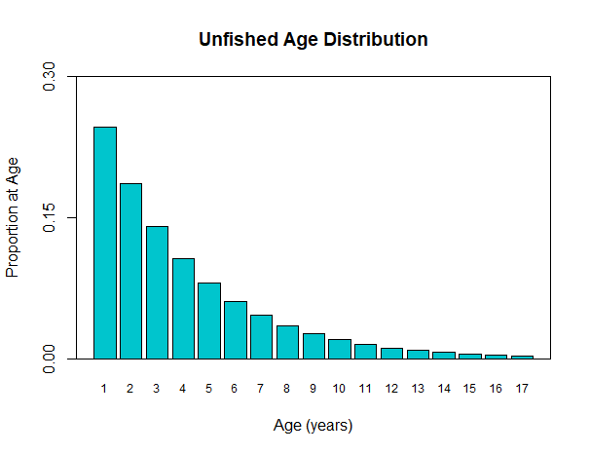
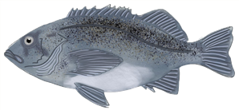
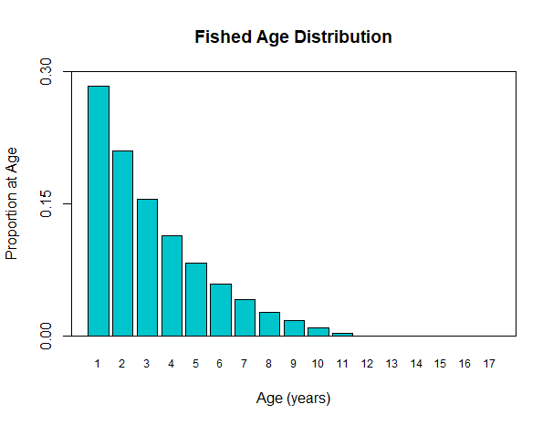
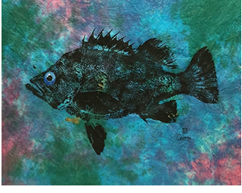
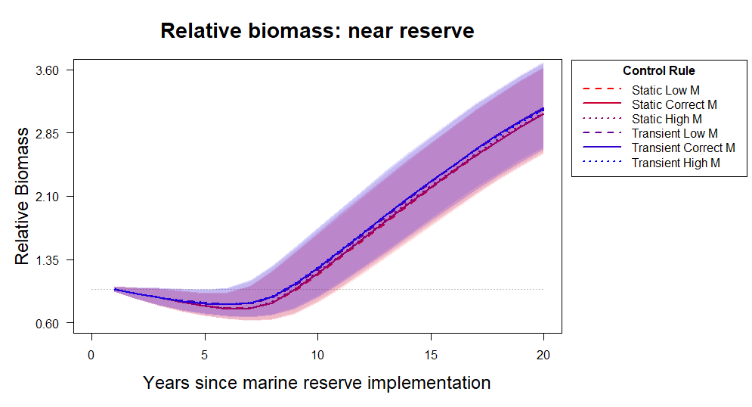
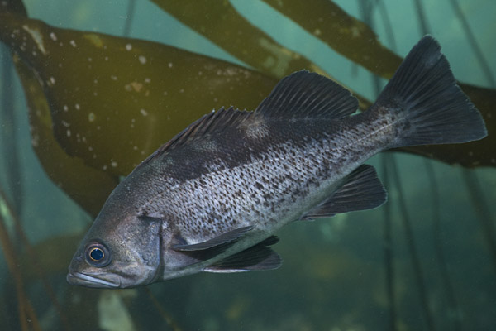
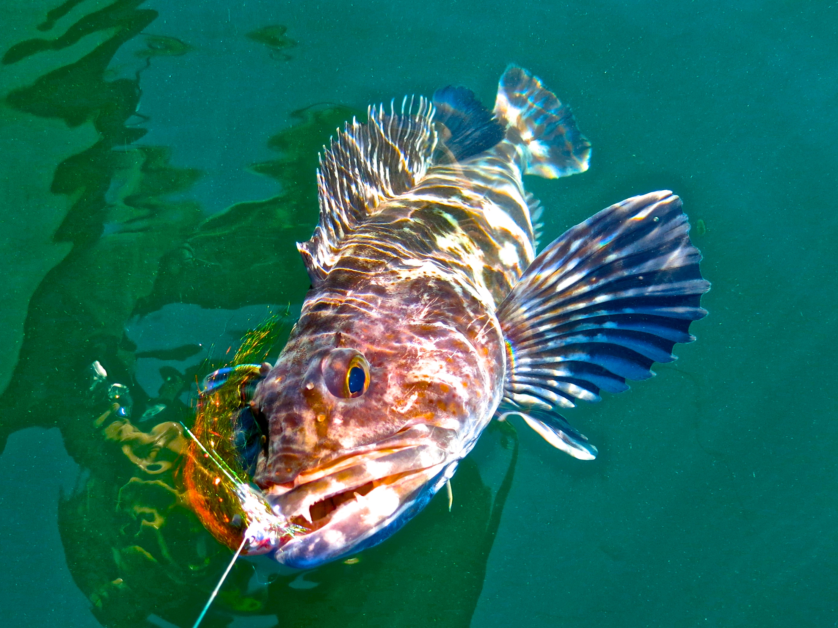
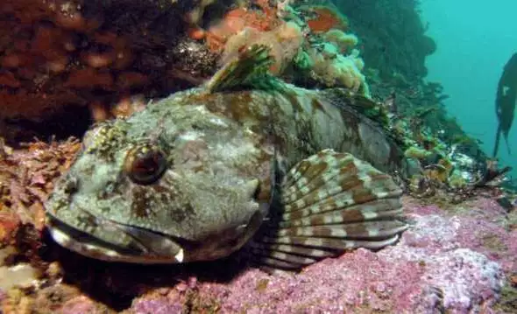
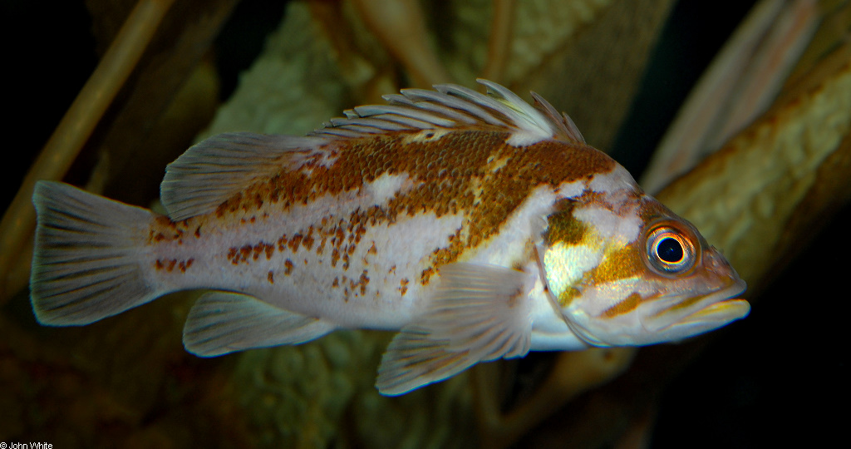


Developing tools to account for population dynamics to improve the
use of no-take marine reserves for fishery management
Victoria Quennessen and J. Wilson White
Department of Fisheries and Wildlife, Oregon State University
http://blogs.oregonstate.edu/whitelab/
victoria.quennessen@oregonstate.edu
@frenchita_
Abstract
Research Questions
Results
Stock assessments are a key tool for fishery management – they estimate how depleted a stock is, and how much we can safely catch
Estimating depletion depends on knowing how big the stock was before fishing started, but this is not usually known
Populations inside marine reserves that are not fished may act as reference populations
These populations experience time lags – there is a transient period as the population goes from the fished state to an unfished state
We are exploring how accounting for these time lags can improve the use of reserves as reference points for assessment and management
How can we best use information from inside reserves to help manage fisheries after reserve implementation?
How does the inclusion of transient dynamics influence the short-term effect of control rules on yield and biomass?
What happens when we don’t have an accurate estimate of natural mortality?
Transient control rules sometimes perform better than static control rules for yield
Plot shows results from 3 simulations
Yield is plotted relative to values at the time the marine reserve was implemented
Conclusions: different simulations show big differences in yield over time given static or transient control rules – what happens when we run many more simulations and look at average trends?
Methods – computational model
The computational simulates the assessment and management of a fished population
Population dynamics (moves the population forward one year based on fish biology)
Imperfect sampling (calculates a reference point)
Area 1
Reserves change the age structure of fished populations over short-term timescales
Area 2
Reserves can reverse the effects of fishing on a fish population’s age structure
Area 3
Transient control rules perform better on average, but variability can mask the effect
Effect of fishing
Management
(applies a control rule for the next year)
Fishing
(removes fish from the population)
Area 4
Unfished
Fished
Area 5
Bigger, older individuals
Bigger, older individuals
* Adapted from [3]
Used life history characteristics from Black Rockfish (Sebastes melanops)
Started the population with the unfished age structure
Model ran with only population dynamics and fishing for 50
At year 50, a reserve is implemented in Area 3, and fishing stops there
Fishing effort is re-distributed between the other areas based on fish biomass
Effect of reserves
Levi
Comparing static and transient control rules
It takes time for reserves to fill the population back in all the way
CR | 1 | 2 | 3 | 4 | 5 | 6
Type | Static | Static | Static | Transient | Transient | Transient
M | Low | Correct | High | Low | Correct | High
The static control rules use the same density ratio over time because it assumes the reserve works right away
The transient control rules use a shifting target density ratio over time (Eq. 1), where t is the number of years after reserve implementation to account for the time lag
During the transition from a fished to an unfished age structure, the stock has transient dynamics (these dynamics are different from equilibrium dynamics, the dynamics unfished stocks have)
The transition is a result of time lags that depend on the biology of the fish, such as:
Natural mortality: species with a lower natural mortality take longer to finish transitioning [2]
Growth rate: species with a lower growth rate take longer to finish transitioning
* Static control rules adapted from [3]
Eq. 1: $Target DR=1 −\left(1 −Final DR\right)∗e^{−Mt}$
* Adapted from [2]
What happens if don’t know the correct natural mortality? For each of 3 scenarios:
Population
Low, correct, or high natural mortality
Sampling
Calculate appropriate density ratio
Management
Apply control rule and set fishing effort for next year for all scenarios
Levi
Jay Nichols
FishWithJD
John White
Plots show results from 10,000 simulations
Yield and biomass are plotted relative to values at the time the marine reserve was implemented
Lines are average values (medians) and shaded areas show interquartile ranges (50% of the values)
Conclusions: there are consistent differences in yield and biomass between transient and static control rules on average, but variability from random recruitment will mask those effects in individual simulations
Black Rockfish (Sebastes melanops)
Lingcod (Ophiodon elongatus)
Cabezon (Scorpaenichthys marmoratus)
Copper Rockfish (Sebastes caurinus)
A new control rule can help manage fisheries around reserves
Acknowledgements
A control rule dictates how high fishing effort can be based on some biological reference point
The current west coast groundfish fishery has a 40:10 control rule
This control rule depends on how big a stock is compared to how big it would be if it was not fished (the unfished biomass)
Density ratio: # fish / area outside reserve
-------------------------------------
# fish / area inside reserve
Benefit: it can be calculated based on only a few years of sampling data, so it can be used for data-poor fisheries
The density ratio can be calculated at local scales
Thanks to support from lab mates Dr. Christian Commander, Montana McLeod, Jennifer Fisher, and Laura Storch; PISCO; Dr. Elizabeth Babcock; and friends and family.
Funding: Oregon State University, The Oregon Lottery Scholarship, and the James Sedell Graduate Scholarship
Next steps
References
Explore the effectiveness of different control rules that incorporate different target density ratios, sample different ages of fish, sample fish from different areas, or sample for longer amounts of time.
Explore effect of control rules on different species: cabezon (Scorpaenichthys marmoratus), lingcod (Ophiodon elongatus), and copper rockfish (Sebastes caurinus).
Incorporate data from Oregon and California marine reserves to adjust the model.
1. J. Lubchenco, K. Grorud-Colvert, Science. 350, 382–383 (2015).
2. J. W. White et al., Conservation Letters. 6, 180–191 (2013).
3. E. A. Babcock, A. D. MacCall, Canadian Journal of Fisheries and Aquatic Sciences. 68, 343–359 (2011).
4. K. A. Kaplan et al., Ecol Appl. 29 (2019), doi:10.1002/eap.1949.
5. K. J. Nickols et al., J Appl Ecol. 56, 2376–2385 (2019).

